Slide 1
Hate Speech Classification
Data Analysis
Approach
Technical Approach
Result

Slide 2
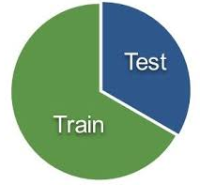
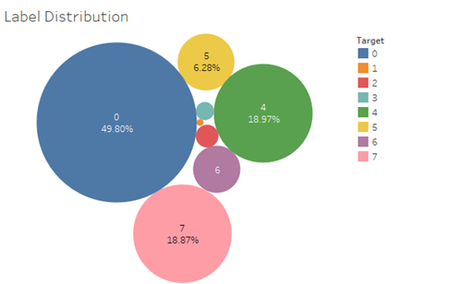
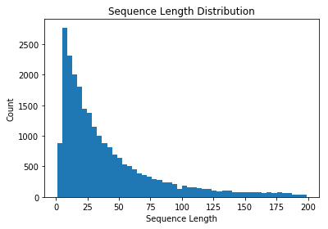
Data Analysis
Hate speech | obscene | insulting | target | Comment Category
0 | 0 | 0 | 0 | not 'hate_speech', 'obscene' and 'insulting
0 | 0 | 1 | 1 | only 'insulting'
0 | 1 | 0 | 2 | only 'obscene'
0 | 1 | 1 | 3 | 'obscene' and 'insulting'
1 | 0 | 0 | 4 | only 'hate_speech'
1 | 1 | 0 | 5 | 'hate_speech' and 'obscene'
1 | 0 | 1 | 6 | 'hate_speech' and 'insulting'
1 | 1 | 1 | 7 | 'hate_speech', 'obscene' and 'insulting'
6327
25307

Slide 3

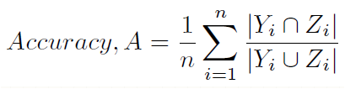
Neural Network Approach
Clean the text, Tokenize, Texts to Sequences and Pad Sequences
Models
Baseline Model
150 inputs -> [100 hidden nodes] -> 8 outputs
Hamming score: 49.21
Pre-Trained GloVe
100 inputs -> [Embedding 20000, 100, weights=[embedding_matrix], input length=100, trainable=False] -> [100 hidden nodes Dense] -> 8 outputs
Hamming score: 49.21
LSTM
150 inputs -> [Embedding 20000, 100] -> [100 hidden nodes LSTM] -> 8 outputs
Hamming score: 77.70
LSTM – CNN
100 inputs -> [Embedding 20000, 100, input_length=100] -> Dropout(0.2) -> Conv1D(64, 5, activation='relu') -> MaxPooling1D(pool_size=4) -> [100 hidden nodes LSTM] -> 8 outputs
Hamming score: 78.91
CNN
100 inputs -> [Embedding 20000, 128, input_length=150] -> Conv1D(64, 5, activation='relu') -> GloballMaxPool1D() -> Dropout(0.2) -> [50 hidden nodes Dense] -> Dropout(0.3) -> 8 outputs
Hamming score: 78.73

Slide 4
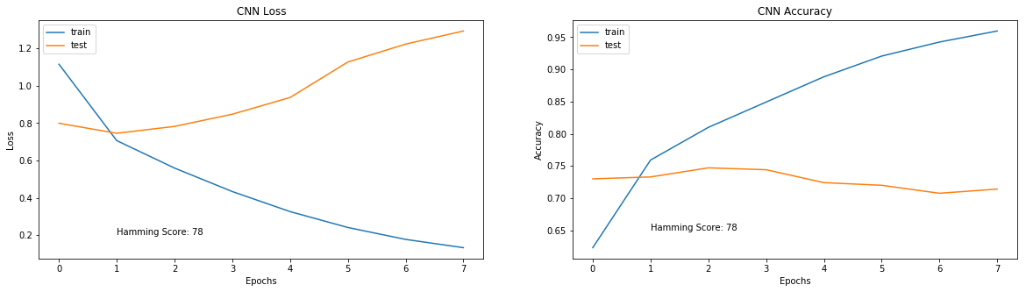
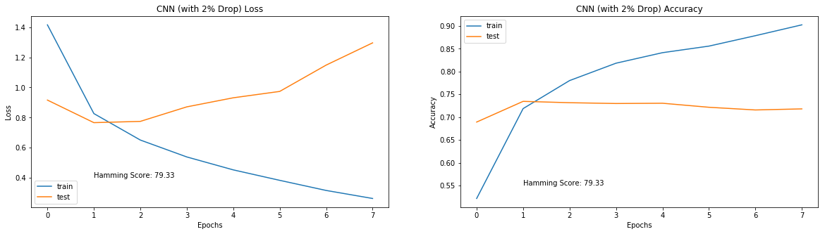
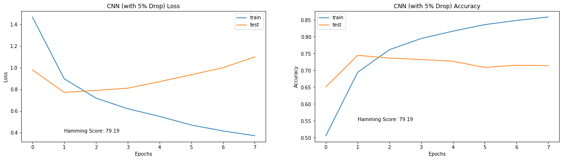
Technical Approach

Slide 5
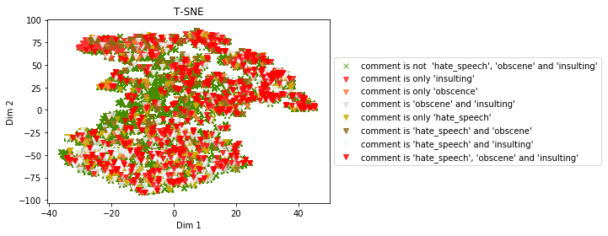
Result

Slide 6
Thank you

